Slide 1




Automatic Concussion Evaluation (ACE)
John Tarasidis - EE
Brian Sang - CompE
Sean Kim - EE
Michael Lee - CompE
Jonathan Park - EE
Dale Shober - BME
Thank you to our sponsors:

Slide 2




The Current Standard of Care
Screening
(Qualitative)
Neuroimaging
(MRI, etc.)
Treatment

Slide 3

An Improved Standard of Care
Quantitative
Neuroimaging
(MRI, etc.)
Treatment

Slide 4
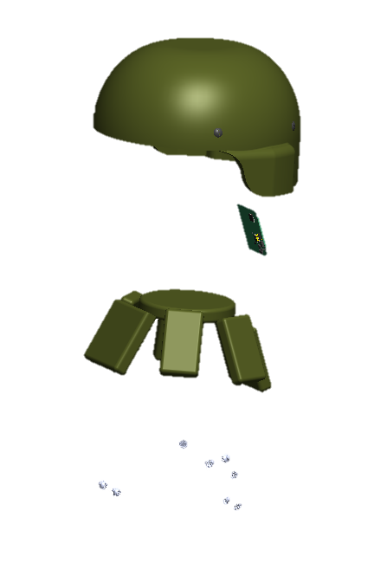
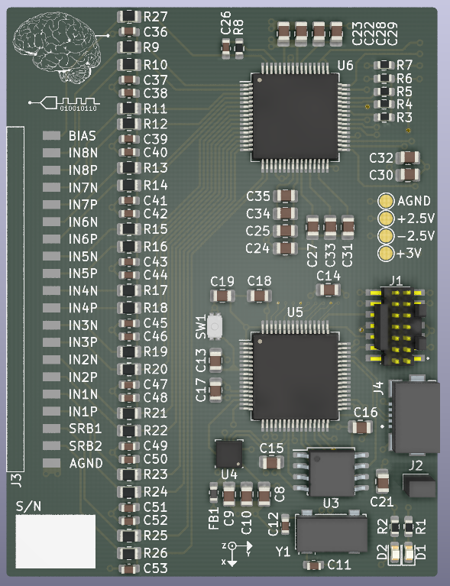
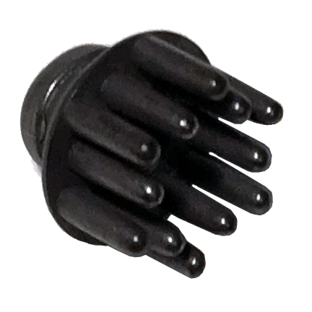
Our Solution

Slide 5
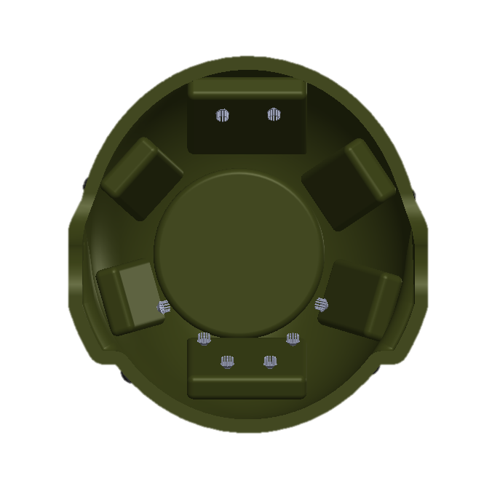
The New Standard of Care
optional
Neuroimaging
(MRI, etc.)
ACE
(Quantitative)
Treatment

Slide 6
Reachable Market
All helmets
15M
1.5M
Active military
27K
Fort Benning
10
In production

Slide 7
Technical Slides

Slide 8

Board

Slide 9
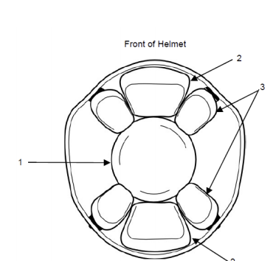
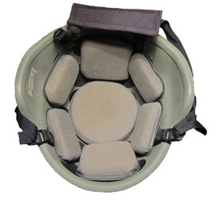
Helmets
Limited space on helmet due to volumetric constraints
EEG electrodes placed mainly near occipital lobe
Unit should fit within 70mm x 70mm x 5mm (W x L x H)
2cm thick pads
Rigid PCB placed in rear (position 4)
Margin of 1cm
Max height of component housing ~5mm
4

Slide 10
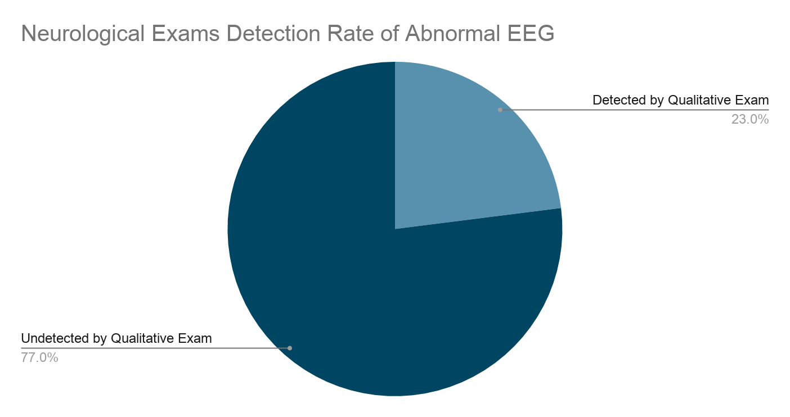
A Sensitive Tool for the Quantitative Screening of Head Injuries
Electroencephalogram (EEG) analysis compared to neurological exams^{[5]}
EEG analysis is shown to be more sensitive than qualitative neurological exams
[5] https://www.ncbi.nlm.nih.gov/pmc/articles/PMC5619208/
Notes:
[4] https://www.ncbi.nlm.nih.gov/pmc/articles/PMC5619208/

Slide 11
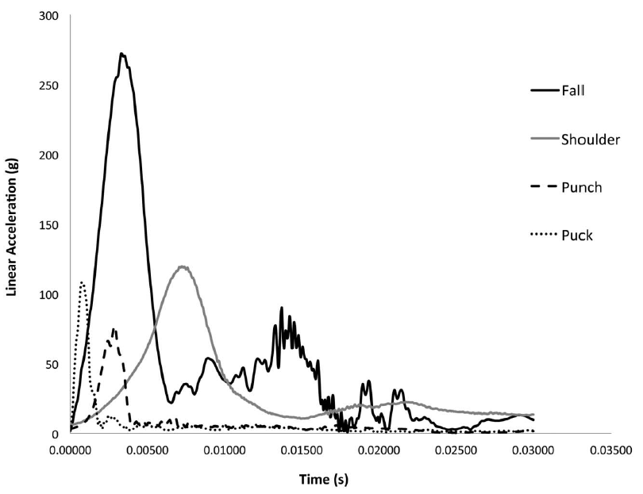
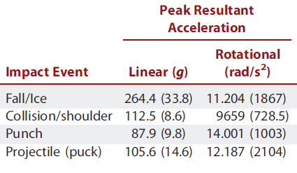
Linear acceleration-time curves

Slide 12
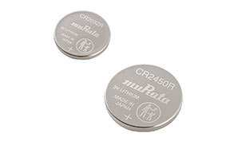
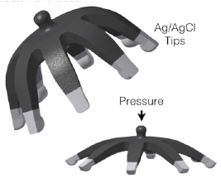
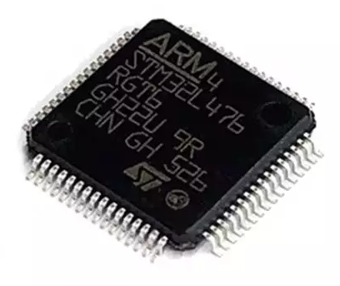
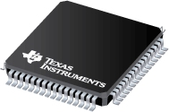
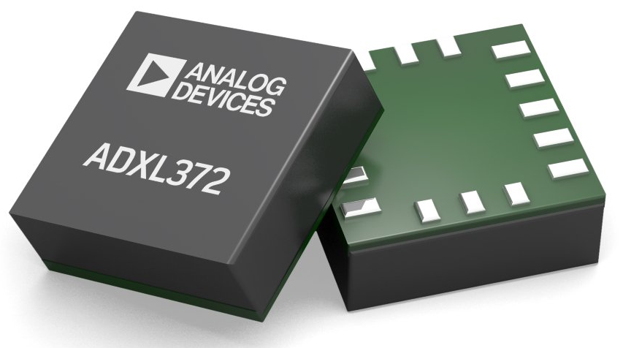
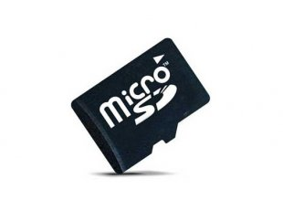
8-Channel System Overview
Analog Voltage ~5V
Digital Voltage ~3V
ADS1299 Biopotential Amplifier and ADC
STM32L4 Series Ultra-Low-Power ARM Cortex-M4 Microcontroller
ADXL372 High-Impact Ultra-Low-Power MEMs Accelerometer
Emphasis on high integration and low power
Mass Flash Memory for Big Data Analysis and External Export
Notes:
https://www.ti.com/lit/ds/symlink/ads1299.pdf?ts=1605462363116&ref_url=https%253A%252F%252Fwww.ti.com%252Fproduct%252FADS1299

Slide 13
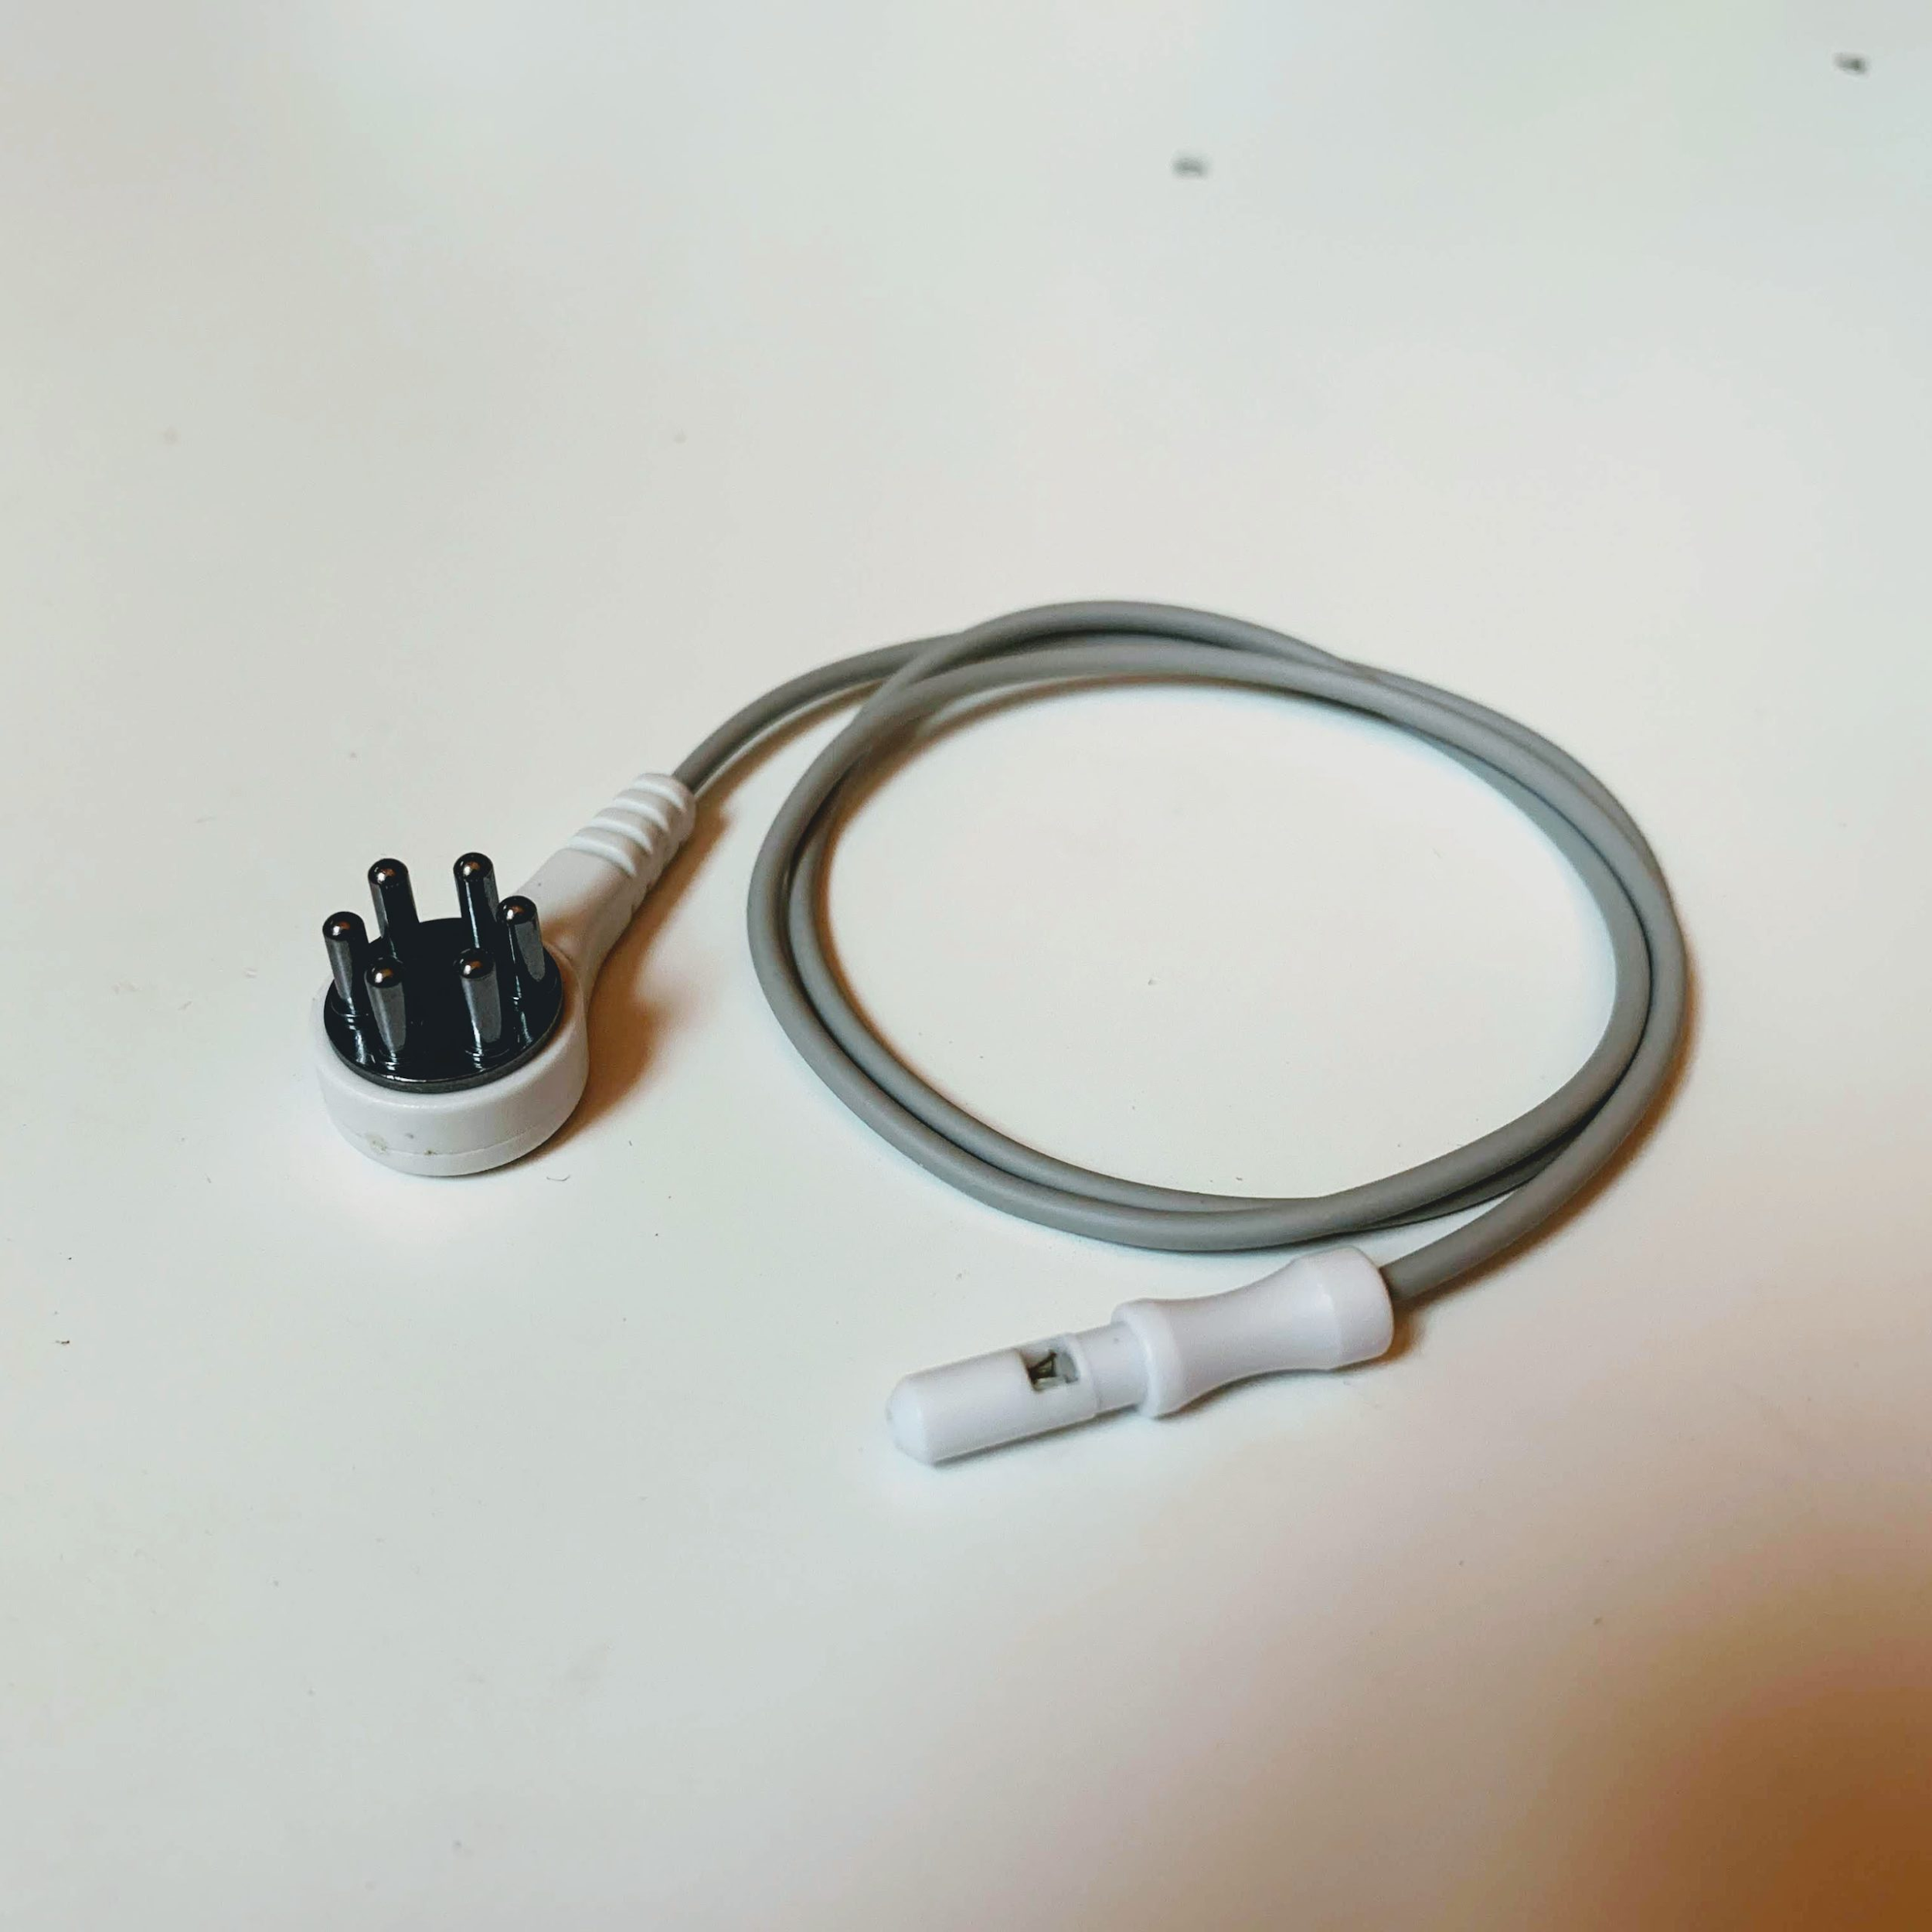
Electrodes
Hot-pluggable systems allows for flexibility in electrode selection
Most promising so far pictured below
What mechanical connector should we use?
Direct through-hole solder joint seems most reliable for shock & vibration
https://www.fri-fl-shop.com/product/reusable-5mm-ag-agcl-spike-snap-electrode-tde-212/

Slide 14
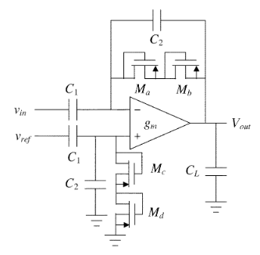
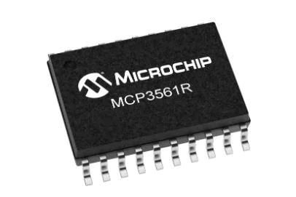
ADS1299 - Deciding Factors
Pros:
High Integration/Small Footprint
Simple Power Control
Flexible Body Potential Bias Schemes
High Resolution
Cons:
Cost
Bottom Line: While discretes were explored the ADS1299 offers the complete package, making up for its cost in reduced development time
versus
x8

Slide 15
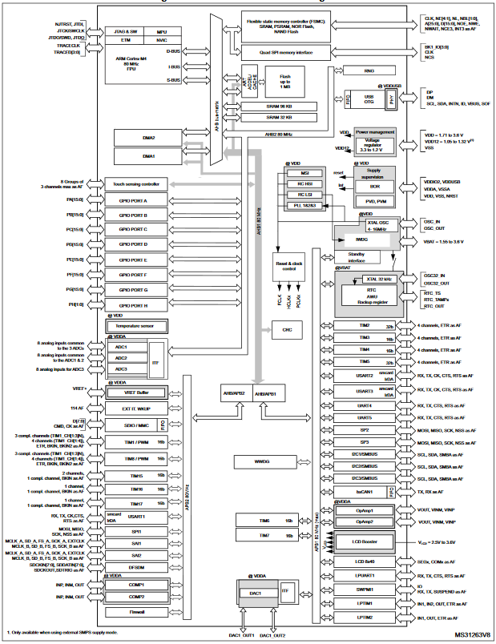
STM32L4 - Deciding Factors
Pros
Low Cost
Best-in-Class Ultra Low Power
Best-in-Class Development Environment
ST HAL, STM32CubeIDE, CMSIS
MBED Enabled
Cons
SDMMC 4 bit bus has silicon errata
Bottom Line: The STM32 microcontroller family is an industry staple. Tried and true, it just makes sense.

Slide 16
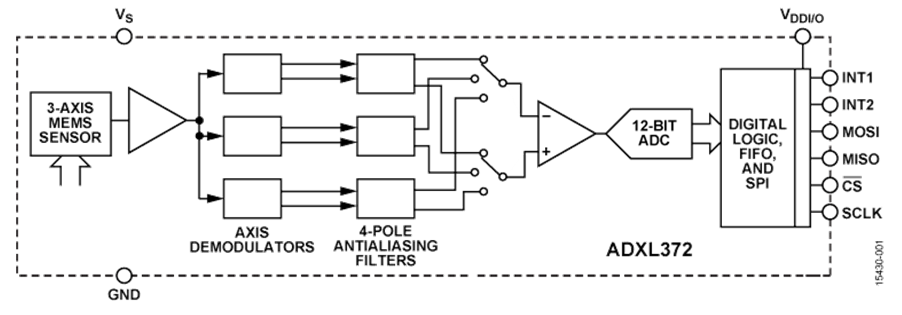
ADXL372 - Deciding Factors
Pros
Best-in-Class Ultra Low Power
High Impact Capable
Programmable Automated Interrupt Generation
Cons
Cost
Bottom Line: While the ADXL372 is expensive, it is unparalleled in capability for our application - where power, measurement range, and interrupt handling are key factors.

Slide 17
Mass Flash Storage - SDMMC
Pros:
Cheap
Easily interfaceable with ST HAL SDMMC
Allows for simple export to an external PC
Good for exploratory algorithm development
Cons:
Large footprint
Weak link in environmental resilience
Requires FatFs, a large middleware library

Slide 18
Power Consumption
Alternate between analysis and low-power sleep modes
Current Consumption
Power supplied by coin cells
Estimated battery life: 6-9 months
Op Mode | ADS1299 | STM32L4 | ADXL372 | Total
Analysis | 8.14mA | 2.6mA | 22uA | ~11mA
Sleep | 1.2uA | 22nA | 1.4uA | 2.622uA

Slide 19
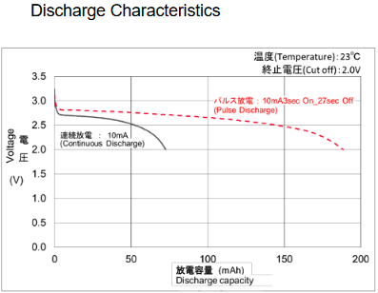
Power Delivery - Digital
Single Cell, Unregulated
IC | Operating Voltage
 | Min | Max
ADS1299 | 1.8 | 3.6
ADXL372 | 1.6 | 3.5
STM32L4 | 1.71 | 3.6

Slide 20
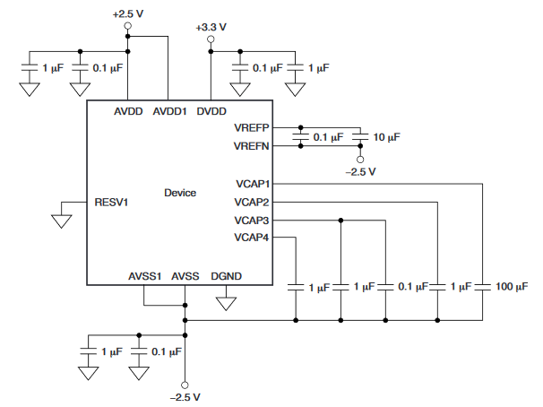
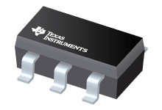
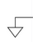
Power Deliver - Analog
Low-Noise LDO Regulated
Center-tapped AGND
Ganged EN Pins to uController GPIO for absolute no-current state in idle mode
ADS1299 SHTDWN pin and LDO EN pins will be brought up in a single GPIO port mask
+2.5V
-2.5V

Slide 21
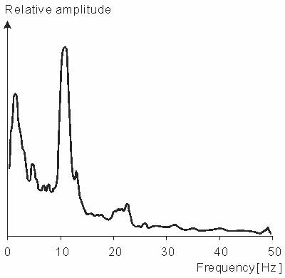
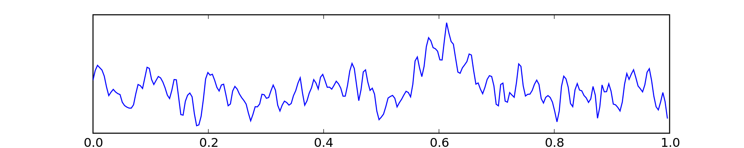
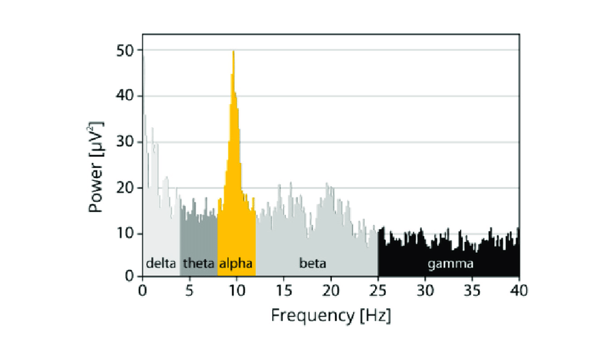
The Screening Signal Path
Frequency Analysis
Baseline Comparison and Notification of Abnormality
Electrodes
Analog Front-end and Digitization
Digital Signal Processing
Power Analysis
High Impact Sensor
Notes:
>make clearer
>be more specific with step by step (include energy and time needed for each step)

Slide 22
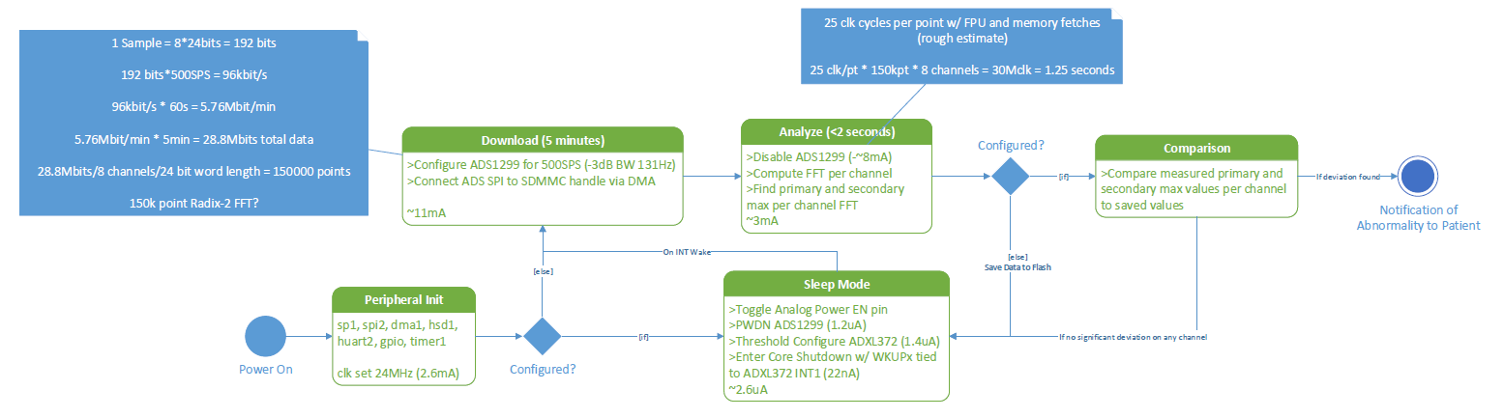
Firmware State Flow
Notes:
>sub-banding
>spectrograms
>spatio temporal output
>match filters sub one second
>become metrics in your classifiers
>look into EEG open source data to play with data in matlab
>get a meeting with the team

